Slide 1
PAPER 1 : Maintenance 4.0: Intelligent and Predictive
Maintenance System Architecture
Sankalp Agrawal

Slide 2
Abstract :
This paper describes the architecture of an intelligent and predictive maintenance system, aligned with Industry 4.0 principles.
It considers advanced and online analysis of the collected data for the earlier detection of the occurrence of possible machine failures, and supports technicians during the maintenance interventions by providing a guided intelligent decision support.
The implementation of such approaches demands a well structured architecture and can be boosted through the use of emergent ICT technologies, namely Internet of Things (IoT), cloud computing, advanced data analytics and augmented reality.

Slide 3
INTRODUCTION:
Nowadays, Industrial maintenance is mainly reactive and preventive.
Predictive strategy only applied for critical situations.
Industry 4.0 uses the available emergent Information and Communications Technology (ICT), e.g., Internet of Things (IoT), Big data, advanced data analytics, cloud computing and augmented reality.

Slide 4
Usually, the maintenance management is categorized into different policies:
(i) corrective or run-to-failure maintenance
(ii) preventive maintenance
(iii) predictive maintenance.
Corrective maintenance is an unscheduled repair, where equipments are allowed to operate until they fail, moment in which a maintenance intervention is performed.
Preventive maintenance, is a regularly performed set of actions on an equipment to lessen the likelihood of it failing.
Predictive maintenance is a philosophy or attitude that uses the actual operating condition of the plant equipments and systems to optimize the plant operations and/or processes

Slide 5
PHM:
The PHM concept is often used with other approaches like predictive maintenance and CBM.
PHM is an engineering process where algorithms are used to detect anomalies, diagnose faults and predict Remaining Useful Lifetime (RUL)
goal of PHM is to provide the health state and estimate the RUL of the components or equipments and financial benefits.
A PHM analysis involves a variety of steps including the collection of data and data characterization, the extraction of features from collected data, and finally the diagnosis and prognosis.

Slide 6
CBM:
Maintenance strategy that collects and assesses real-time information, and recommends maintenance decisions based on the current condition of the system.
CBM policies predict the remaining useful life based on the currently observed system state, and suggests system inspection and maintenance actions.
it allows end users to perform better-planned maintenance, reduce or eliminate unnecessary inspections, and decrease time-based maintenance intervals with confidence.

Slide 7
OSA-CBM:
Open System Architecture for Condition-Based Maintenance (OSA-CBM), held by MIMOSA, representing formats and methods for communicating, presenting, and displaying relevant information and data.
OSA-CBM comprised seven generic layers to attain a well constructed system, but currently considers six functional blocks:
Data Acquisition
Data Manipulation
State Detection
Health Assessment
Prognostics Assessment
Advisory Generation

Slide 8
SYSTEM ARCHITECTURE:
The system functionality is initiated with the Data Collection module, where the data from several sources is collected and stored in a database.
This database will feed the Offline Data Analysis module, where advanced data analytics, machine learning and cloud technologies are used to perform the knowledge generation.
The outputs of this module are the generation or adjustment of rules, procedures and facts, which will be used by the Dynamic Monitoring functional block.
The Dynamic Monitoring module is divided into two components, the Visualization and the Early Detection of Failures.
The Visualization component allows to compare Key Performance Indicators (KPIs) against the expected operational limits.

Slide 9
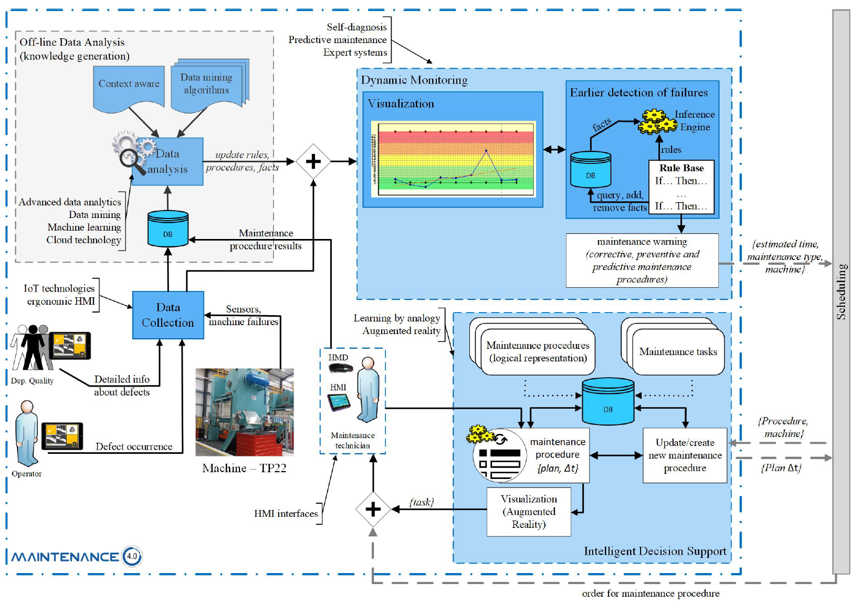
System architecture for the intelligent and predictive maintenance 4.0

Slide 10
OFFLINE DATA ANALYSIS:
The algorithm was trained from the input data of previous events/faults, labeled accordingly to the type of event (fault or operation).
The evaluation of this machine learning approach was tested on two types of recurrent neural networks (RNN), the long short-term memory (LSTM) and the gated recurrent unit (GRU).
The input data consists in more than 43000 previous events, each of which is represented by a preprocessed encoded feature vector that encodes the event type (e.g. sensor activation, axis error, missing parts, etc.)
The data was separated into a training and validation set and a testing set by 70% and 30%, respectively.

Slide 11
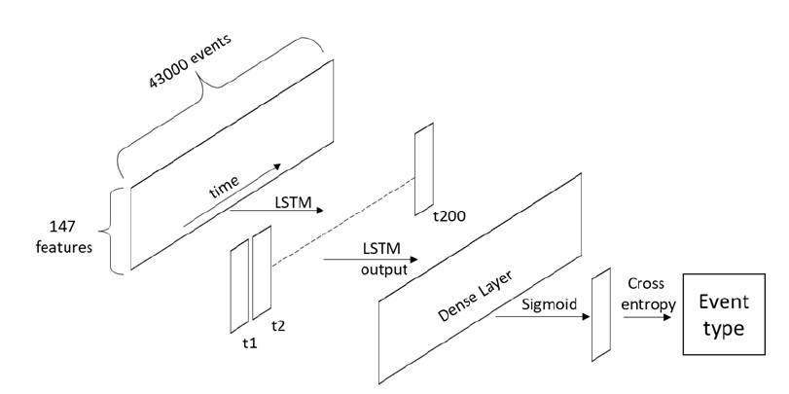
Proposed RNN model architecture based on a LSTM layer to predict the next failure/event type.

Slide 12
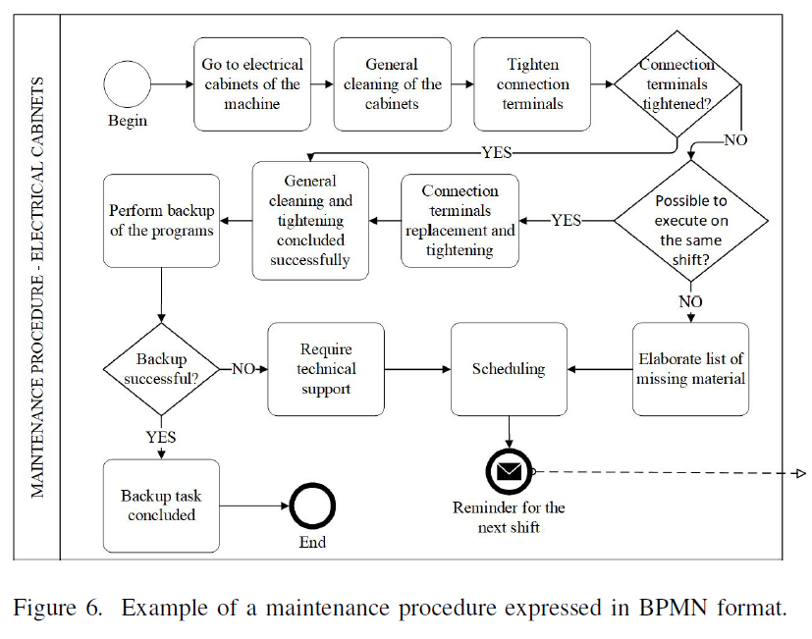
Intelligence of decision support engine

Slide 13
Augmented reality:
AR is an interesting technology as it enhances the user’s interaction and the perception of the real world by supplementing it with virtual things that coexist in the same space as the real ones.
Since its origination, several AR applications have been envisioned and conceived to the manufacturing sector, such as assembly, maintenance, and repair of machinery.
There have been several systems demonstrating the ability and usefulness of AR to act as an instruction and guidance tool.

Slide 14
PAPER 2 : Remaining Useful Life Prognosis for Turbofan Engine
Using Explainable Deep Neural Networks with
Dimensionality Reduction

Slide 15
Abstract:
This study prognoses the remaining useful life of a turbofan engine using a deep learning model, which is essential for the health management of an engine.
The proposed deep learning model a ords a significantly improved accuracy by organizing networks with a one-dimensional CNN, LSTM, and Bi-LSTM.
Dimensionality reduction in the model reduces the complexity and prevents overfitting, while maintaining high accuracy.

Slide 16
OVERVIEW:
To predict the turbofan engine’s RUL, among the machine learning algorithms, multilayer perceptron, support vector regression, and relevance vector regression are compared with the recent convolutional neural network (CNN) algorithm.
In this case, the CNN algorithm showed higher accuracy, and higher accuracy was obtained by constructing a deep CNN model with five CNN layers.
in a recurrent neural network (RNN), the long short-term memory (LSTM) algorithm was used to solve the gradient descent problem in which the learning effect decreased as the layer deepened during training.
In addition, the RUL of the turbofan engine was predicted through a standard deep belief network (DBN) and a semi-supervised deep architecture It was also shown that the accuracy improved when RUL was predicted by combining the CNN and LSTM algorithms

Slide 17
Dimensionality reduction:
Dimensionality reduction involves transforming data from a high-dimension to low-dimension while maintaining critical characteristics of the original data.
There are two methods of dimensionality reduction:
feature selection
feature projection
Feature selection simplifies the model by removing redundant data or less-relevant variables.
Eg: correlation analysis or regularization
feature projection uses all the data to create a new combination of features.
Eg: PCA or autoencoders.

Slide 18
Correlation Analysis and Regularization
Feature selection differs from feature projection in that it maintains the index of the original sensor and performs during the preprocessing or pre-learning stage.
There are three methods of feature selection:
Filter
Wrapper
embedded methods.
The filter method is a method of selecting a feature before the learning algorithm.
The wrapper method detects the interaction between variables and evaluates the subset by finding the ideal combination of features through cross-validation.

Slide 19
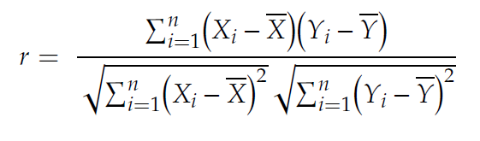
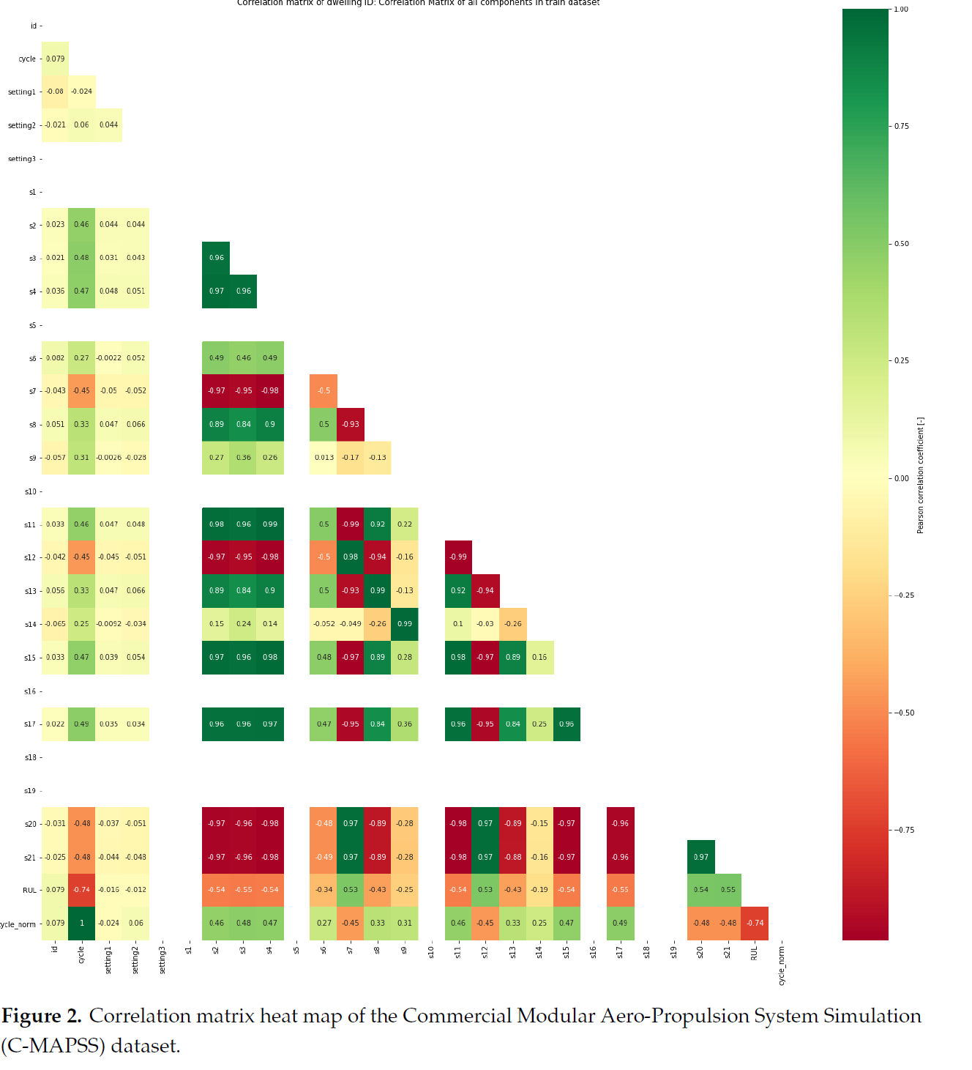
Pearson correlation analysis analyzes the bivariate correlation between two variables and is expressed as follows:
Correlation matrix heat map of the Commercial Modular Aero-Propulsion System Simulation (C-MAPSS) dataset.

Slide 20
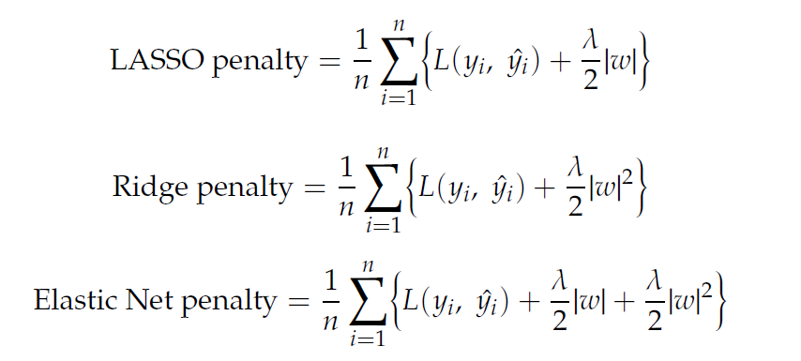
The formula for each regularization
LASSO adds a penalty proportional to the weight’s absolute value
Ridge adds a penalty proportional to the square of the weight.
Elastic Net has the feature of adding all penalties imposed by LASSO and Ridge.
LASSO has the characteristic of reducing the feature with little influence to 0, removing it, and selecting only the significant influencing features.

Slide 21
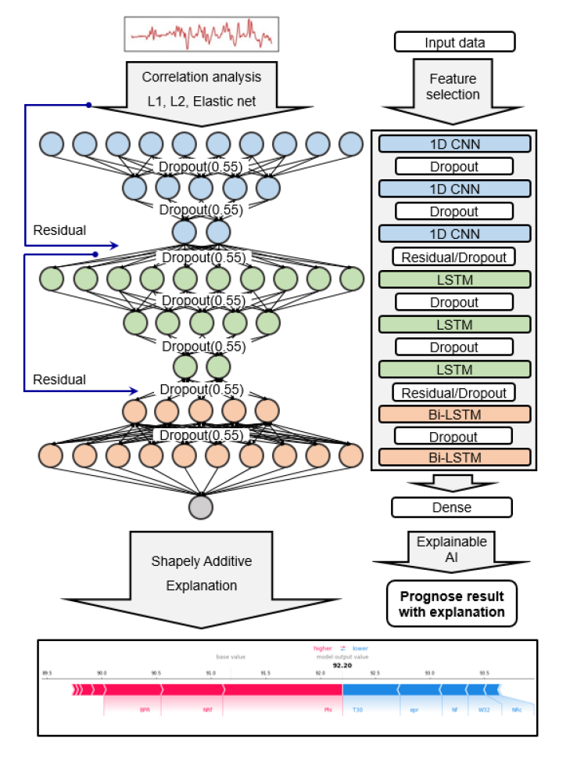
Proposed deep-stacked convolutional bidirectional LSTM model with dimensionality reduction and explainable artificial intelligence

Slide 22
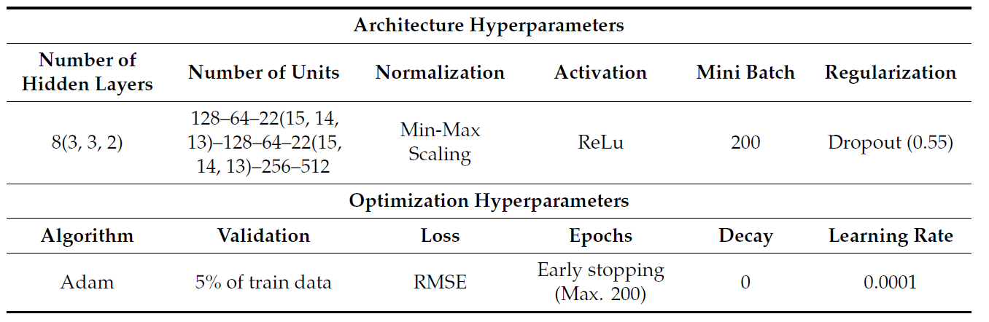
Hyperparameter Setup and Evaluation Metrics
Hyperparameters for deep-stacked convolutional bidirectional LSTM model

Slide 23
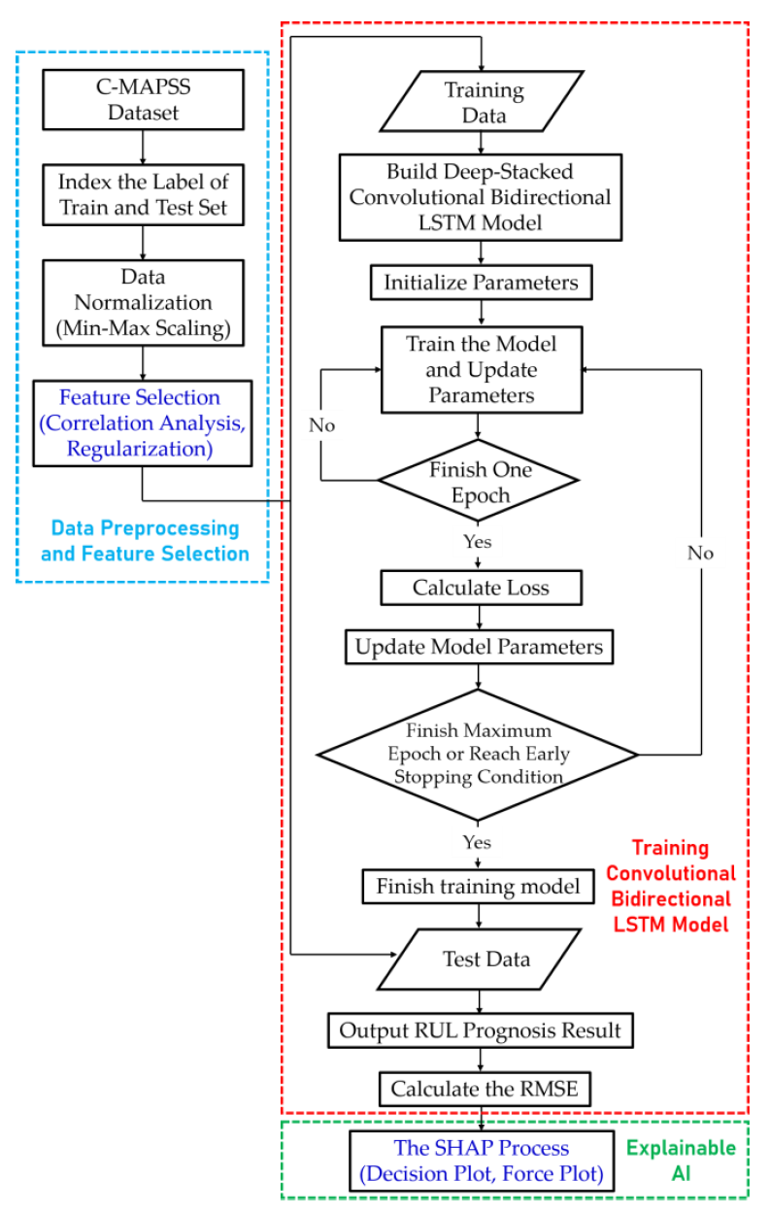
Flowchart of RUL Prognosis

Slide 24
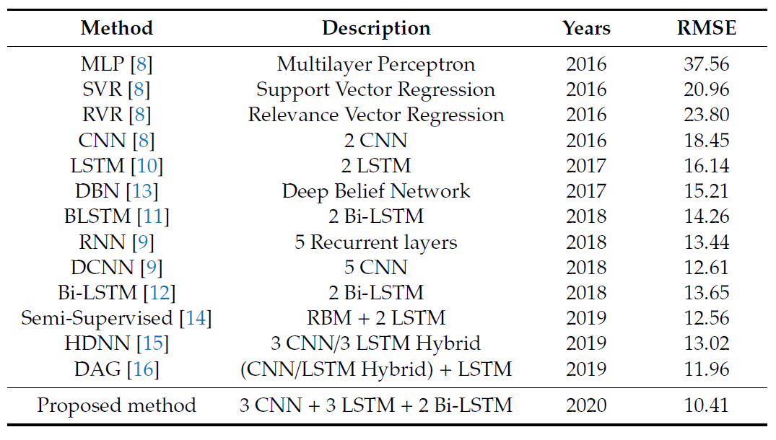
Comparison of the prognosis RMSE results with other algorithms

Slide 25
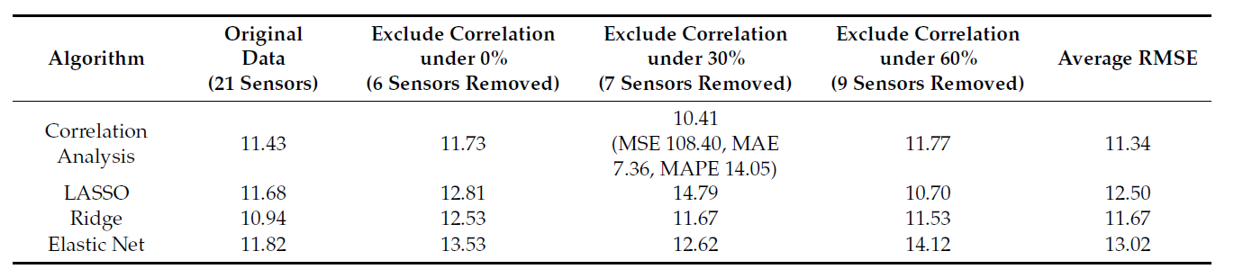
RUL prognosis RMSE result with feature selection method

Slide 26
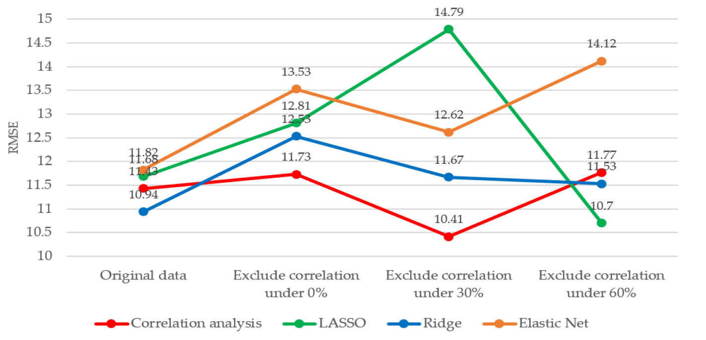
Comparison of RMSE for different feature selection methods.

